Slide 1

CSA-0503 TECHNICAL PRESSENTATION
DATABASE MANAGEMENT SYSTEM
BY
MOHANARANGAN.S(192511439)

Slide 2



INTRODUCTION
Data models define how data is stored and organized.
They represent relationships among data.
Common data models are:
Hierarchical
Network
Relational

Slide 3

What is a Data Model?
Data Model
Blueprint for organizing data.
Defines structure and relationships.
Used in database design.
Ensures efficient data management.

Slide 4
HIERARCHICAL MODEL
Tree-like structure.
Parent–Child relationship.
Supports one-to-many relationship.
Fast data access.
Difficult to represent many-to-many relationships.
.

Slide 5
NETWORK MODEL
Graph structure.
Supports many-to-many relationships.
Records connected through links.
More flexible than hierarchical model.
Complex to design.

Slide 6
RELATIONAL MODEL
Data stored in tables.
Uses rows and columns.
Connected using Primary Key and Foreign Key.
Easy to understand.
Most widely used database model

Slide 7
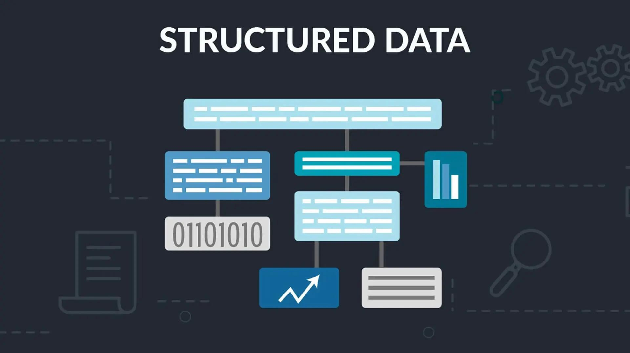
Importance of Data Models
Organize data in a structured manner.
Define relationships between data.
Reduce data redundancy.
Improve data consistency and accuracy.
Make data retrieval faster and easier.
Support efficient database management.
Help in designing reliable database systems

Slide 8
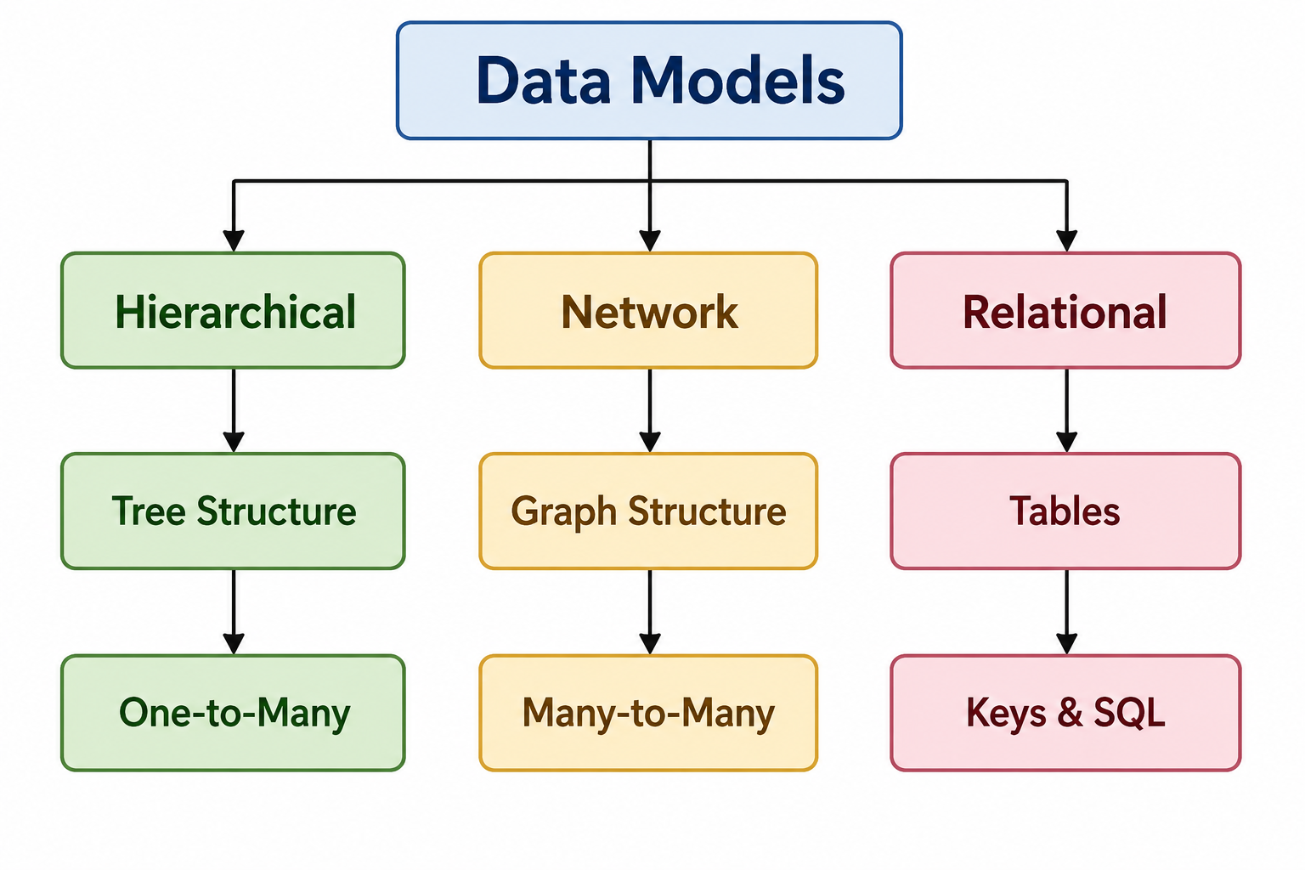
Key Points
Hierarchical uses a tree structure.
Network uses linked records.
Relational stores data in tables with relationships.

Slide 9

Advantages
Hierarchical
Simple implementation.
Fast access for tree-structured data.
Network
Supports complex relationships.
Efficient data navigation.
Relational
Easy maintenance.
High flexibility.
Strong security.
Supports SQL queries.

Slide 10

CONCLUSION
Data models provide different ways to organize and manage data.
The Hierarchical Model is best for simple parent-child relationships.
The Network Model is suitable for complex many-to-many relationships.
The Relational Model is the most popular because it is flexible, easy to use, and supports SQL.
Choosing the right data model improves database performance and efficiency.

